Slide 1

What Are the Differences in Study Time and Lifestyle Between College and High School Students?
Monica Lamichhane
Data science and statistics

Slide 2
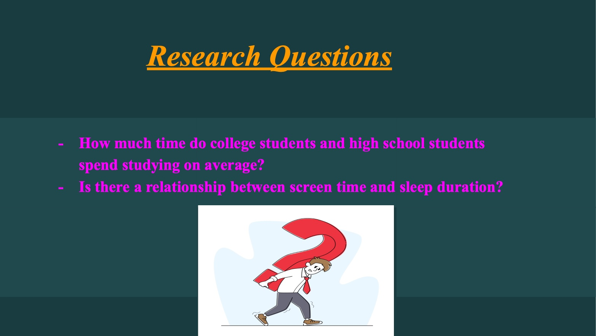

Slide 3
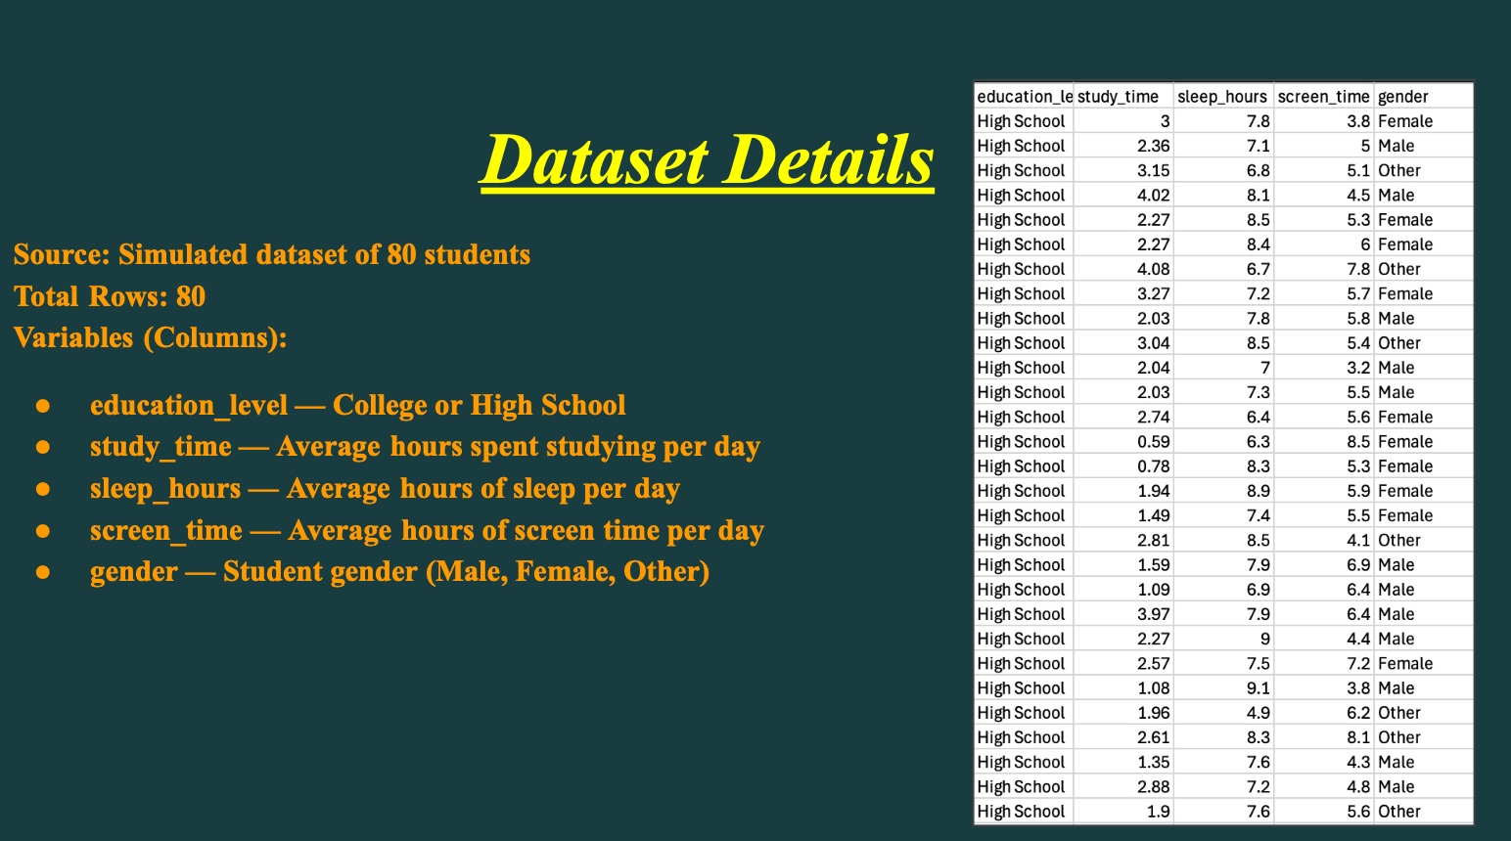

Slide 4
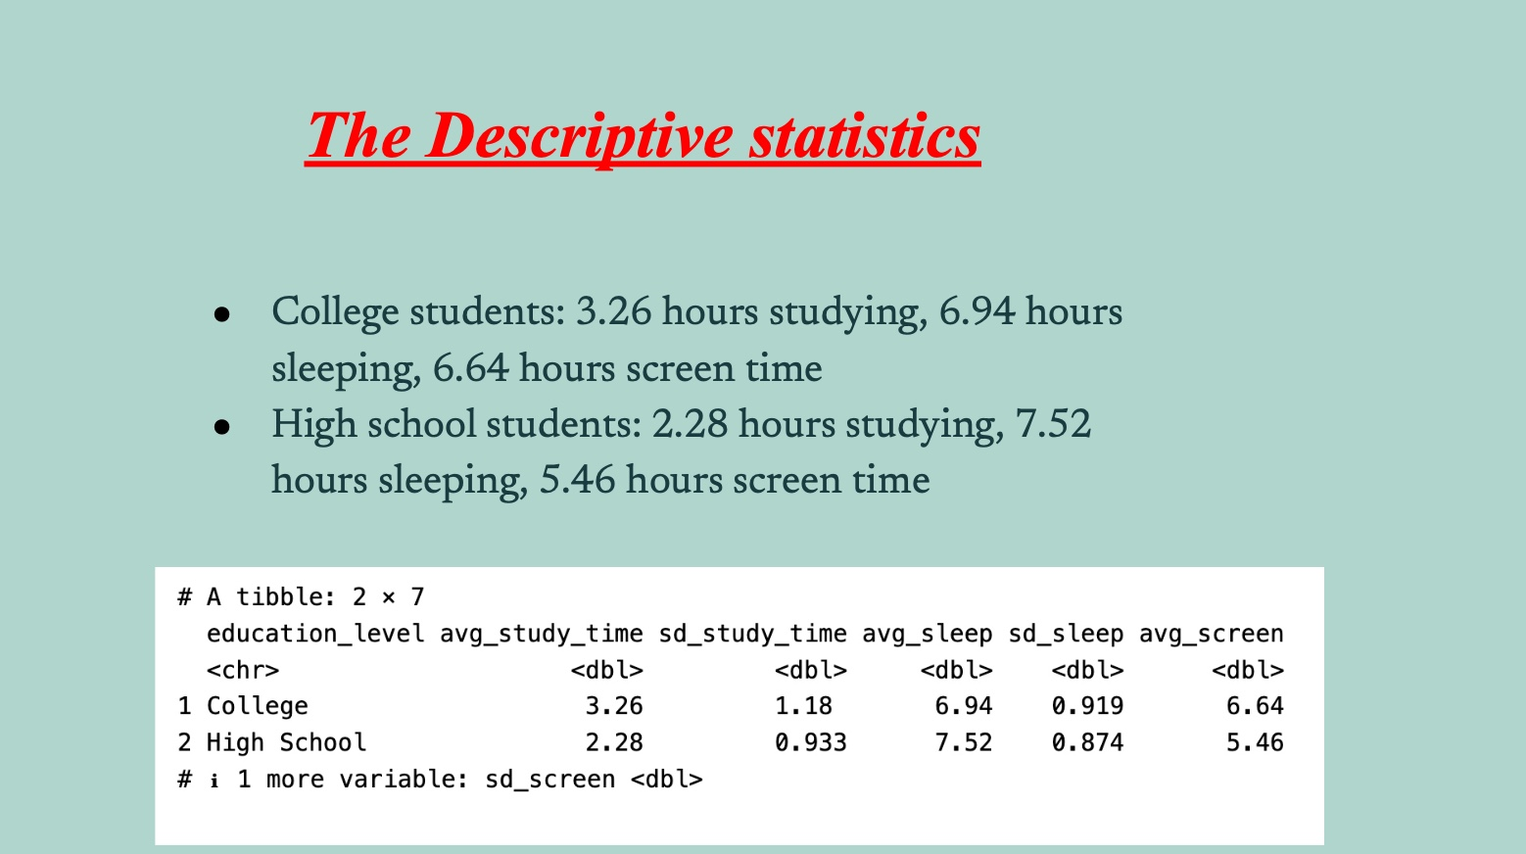

Slide 5
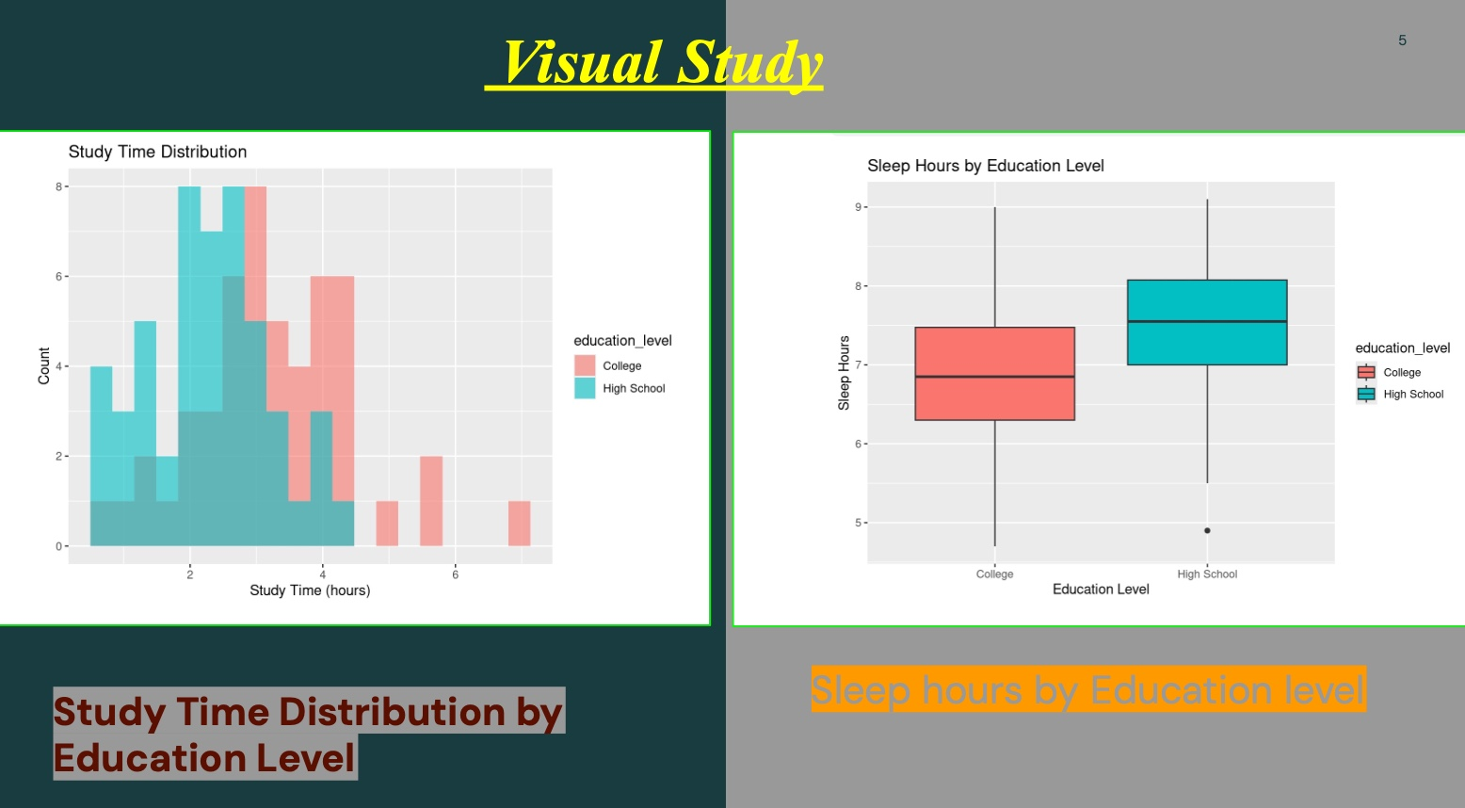

Slide 6
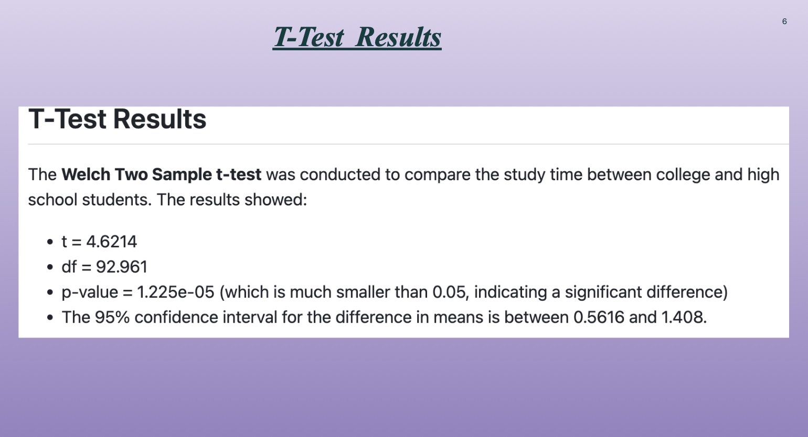

Slide 7
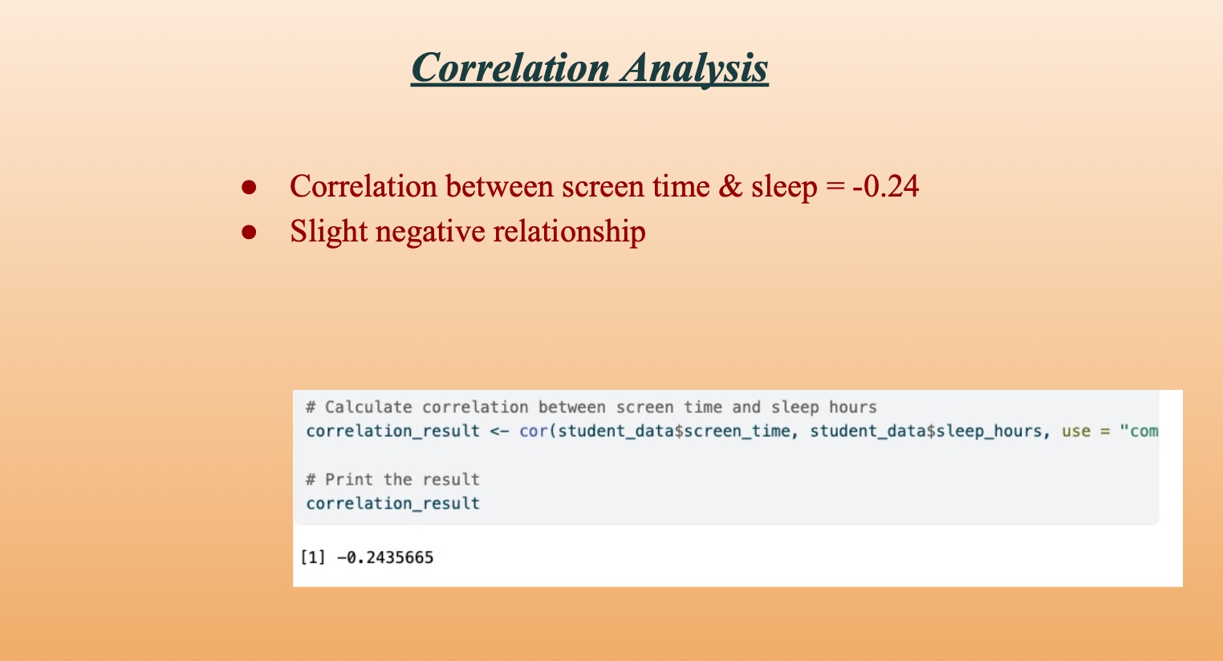

Slide 8
